Slide 1
Lecture 6c Sequences and Recurrence Relations

Slide 2
Sequence
Informal definition: A sequence is a set of elements written in a row.
a_{m}, a_{m+1}, a_{m+2}, … , a_{k}, …, a_{n-1}, a_{n}
Formal definition: A sequence is a function defined on a totally ordered set
{m,m+1,…,n}→R.
term
index, subscript

Slide 3
Sequence
term
index, subscript
3
Most often – infinite sequences
a_{m}, a_{m+1}, a_{m+2}, … , a_{k}, …
Formal definition: A sequence is a function defined on a totally ordered set
N^{≥m}→R.

Slide 4

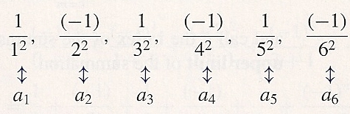
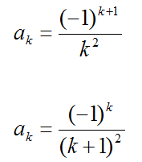
Example
, …
Explicit formula (general formula)
∀k≥1
or
∀k≥0

Slide 5
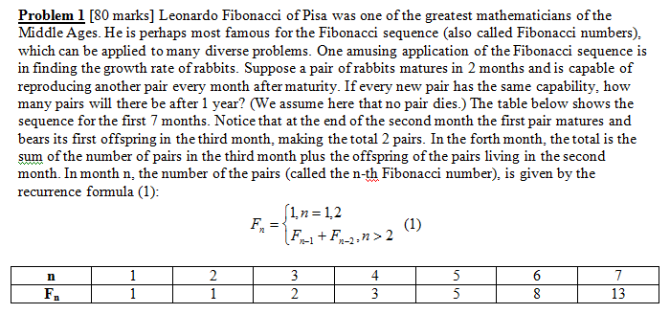
Example: Fibonacci numbers
Recurrence relation
Sometimes Fibonacci numbers are shown starting from 0
n | 0 | 1 | 2 | 3 | 4 | 5 | 6 | 7
F_{n} | 0 | 1 | 1 | 2 | 3 | 5 | 8 | 13

Slide 6

Fibonacci Numbers

Slide 7
Fibonacci Numbers

Slide 8
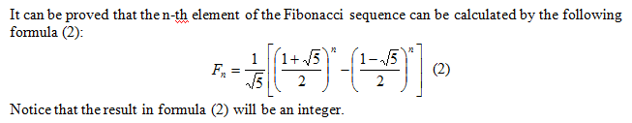
Example: Fibonacci numbers 2
Explicit formula

Slide 9



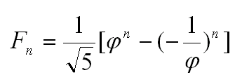
Example: Fibonacci numbers 2
Explicit formula
Note that is called Phi. Then and therefore
Phi ≈ 1.618 ≈ 5/3
Phi is also called “The golden ratio”.
Also, - 1/ φ = , and therefore

Slide 10
Defining a Sequence
Listing all or the first few elements
Misinterpretation possible, difficult to find the n^{th} element of the sequence
Explicit formula
Best
Recursively: Recurrence relation + initial conditions
To find the n^{th} element we need to calculate all preceding elements

Slide 11
Defining a Sequence
Listing all or the first few elements
Misinterpretation possible, difficult to find the n^{th} element of the sequence
…

Slide 12
Defining a Sequence
Explicit formula
Best

Slide 13
Defining a Sequence
Recursively: Recurrence relation + initial conditions
To find the n^{th} element we need to calculate all preceding elements

Slide 14

Recurrence Relation
Recurrence relation: a formula that relates a term a_{k} to certain number of its predecessors, e.g., a_{k-1}, a_{k-2}, …, a_{k-i}
If i predecessors used then i initial conditions needed

Slide 15
Solving a Recurrence Relation
Solving a recurrence relation – finding an explicit formula that defines the same sequence
Solution to a recurrence relation not always exists
We will study 5 methods for solving recurrence relations

Slide 16
Algorithm Efficiency and Recurrence Relations
Running time, t_{n} is a sequence (a function
N→R⁺)
In many programs (especially recursive programs, but not only) efficiency (e.g., t_{n}, c_{n}) can be expressed as a recurrence relation
We would then like to solve the recurrence relation and find an explicit formula
n | 1 | 2 | 3 | …
t(n) | 3 | 7 | 12 | …

Slide 17
Fibonacci Numbers Program 1 – using direct formula
from math import *
def fibonacci(n):
sqrt_5 = sqrt(5)
phi = (1 + sqrt_5) / 2
return 1/sqrt_5 * (phi**n -(1-phi)**n)

Slide 18
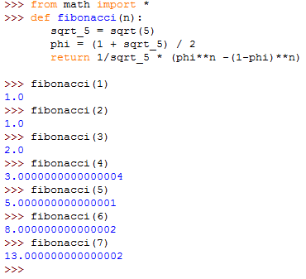

Slide 19
Fibonacci Numbers Program 1 – using direct formula
t_{n} = Θ(1) + 2texp_{n}
We will study exponentiation later
The standard solution is Θ(n)
More efficient implementation is Θ(logn)
t_{n} = Θ(1) + 2Θ(n)) = O(n) , or
t_{n} = Θ(1) + 2Θ(logn) = O(logn)

Slide 20
Fibonacci Numbers Program 2 – iterative solution

Slide 21
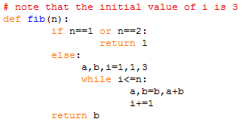
Fibonacci Numbers Program 2 – iterative solution

Slide 22
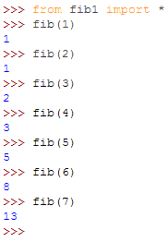

Slide 23
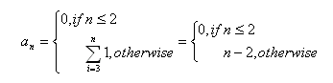

Fibonacci Numbers Program 2 – iterative solution
additions

Slide 24
Fibonacci Numbers Program 3 – recursive solution

Slide 25


Fibonacci Numbers Program 3 – recursive solution

Slide 26
Fibonacci Numbers Program 3 – recursive solution
c_{n} – function calls
1, if n=1,2
c_{n} =
1 + c_{n-1} + c_{n-2}

Slide 27
Fibonacci Numbers Program 3 – recursive solution
We will prove later that
c_{n} = Θ( ) = Θ(φ^{n}) ≈ Θ((5/3)^{n})
Exponential
c₄₀ > 300,000,000

Slide 28
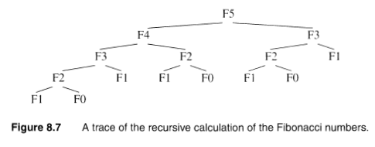
Fibonacci Numbers Program 3 – recursive solution

Slide 29
Fibonacci Numbers
Summary: 3 programs
Θ(logn)
Θ(n)
Θ(φ^{n})

Slide 30


Example 2: Factorial
It is a sequence
Explicit formula difficult to find
Equivalent formula:
1, if n = 0
fact(n) =
1*2*3*…*(n-1)*n, if n>0 =

Slide 31

Example: Program 1 (iterative) to calculate Factorial
fact = 1
for i in range(1, n+1):
fact *= i
[fact = fact * i]

Slide 32
Example: Program 1 (iterative) to calculate Factorial
fact = 1
for i in range(1, n+1):
fact *= i
m_{n} = n = Θ(n)
multiplications
32

Slide 33

Example: Program 2 (recursive) to calculate Factorial
def facRec(n):
if n ==0:
return 1
else:
return facRec(n-1) *n

Slide 34
Example: Program 2 (recursive) to calculate Factorial
def facRec(n):
if n ==0:
return 1
else:
return facRec(n-1) *n
We expressed the efficiency using a recurrence relation
0, n=0
m_{n} = multiplications
m_{n-1} + 1, n>0
We will see that here also m_{n} = n = Θ(n)
(iterative and recursive solutions are of the same order; but overhead for recursive function calls)

Slide 35
Example: Program 2 (recursive) to calculate Factorial
def facRec(n):
if n ==0:
return 1
else:
return facRec(n-1) *n
1, n=0
t_{n} = multiplications + subtractions
t_{n-1} + 2, n>0

Slide 36
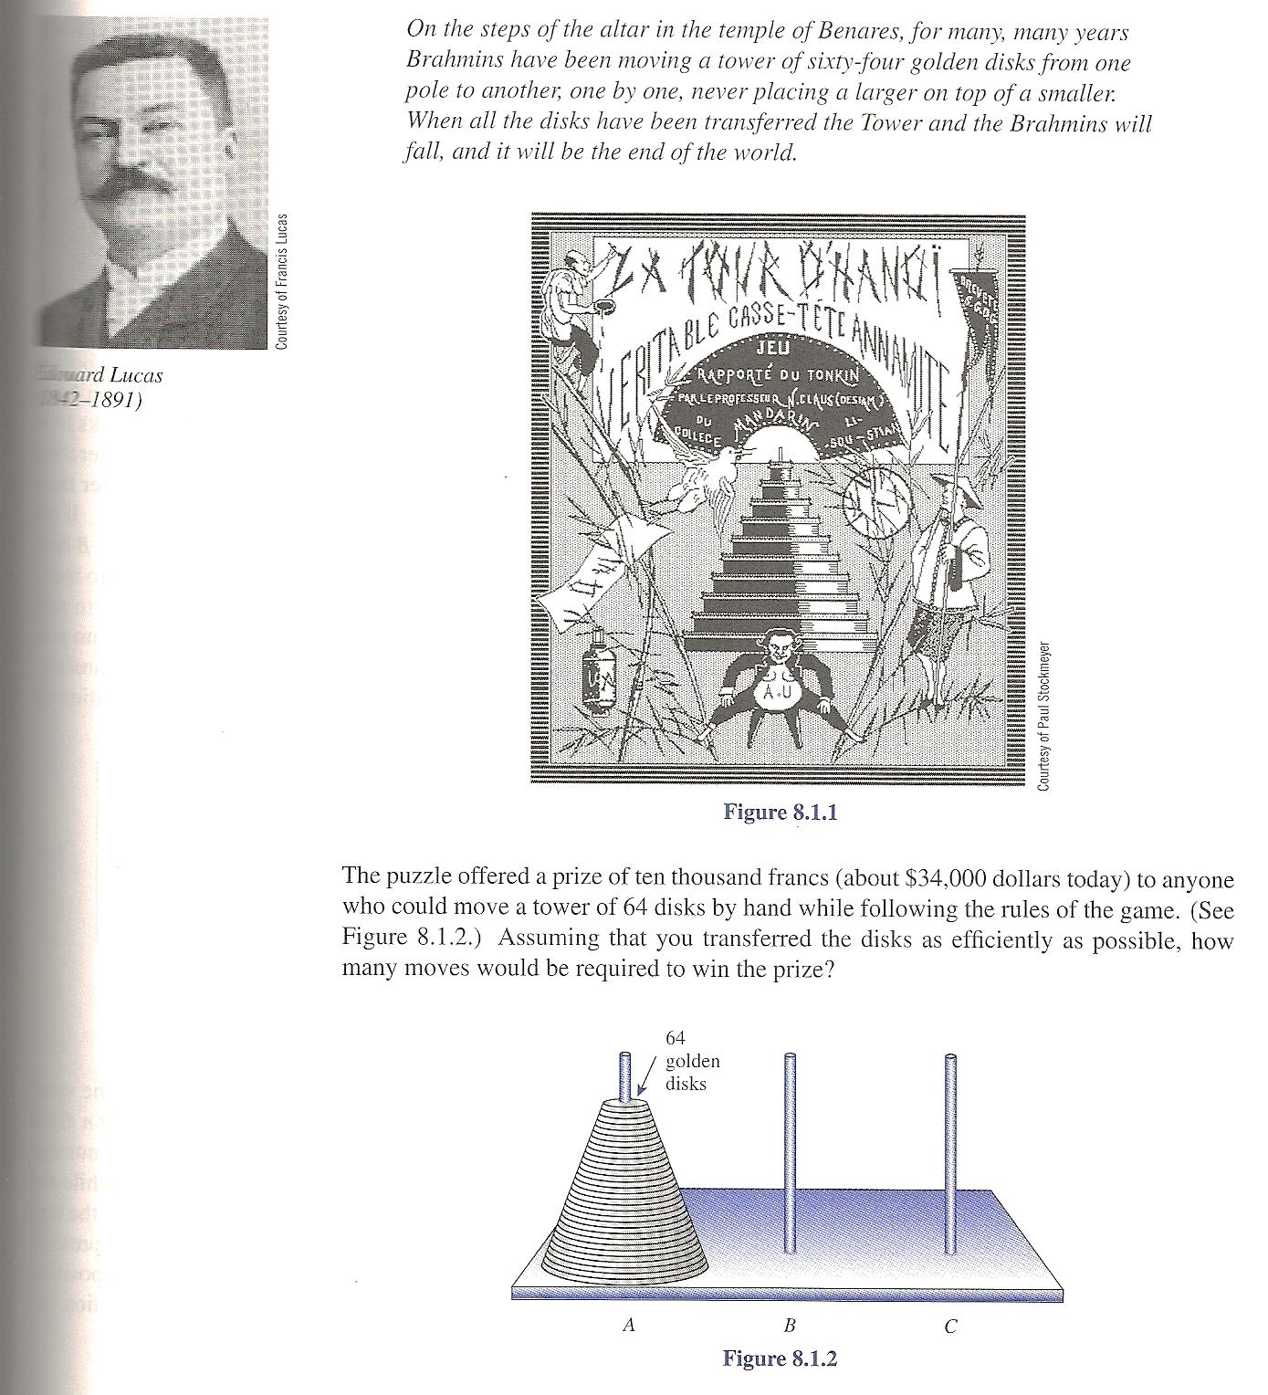
Example 3: Towers of Hanoi

Slide 37
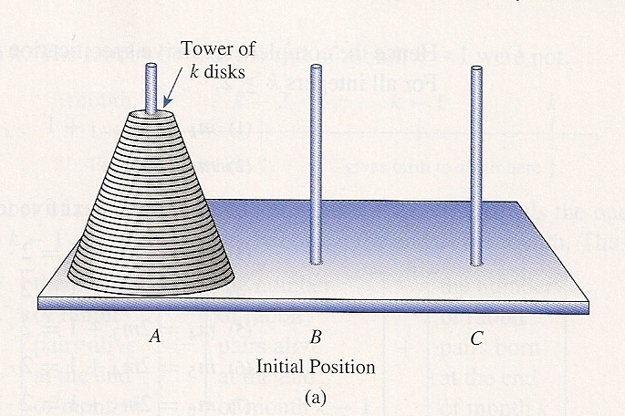
Example: Towers of Hanoi

Slide 38
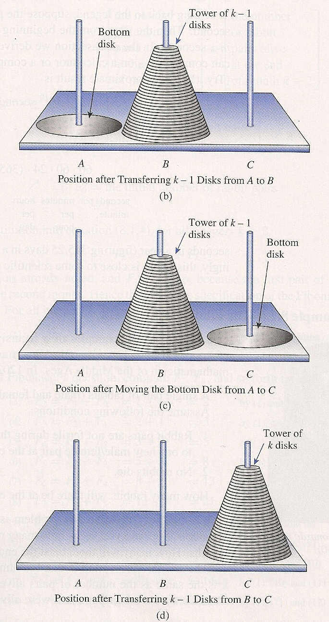

Slide 39
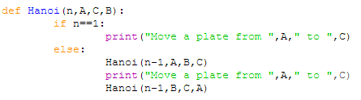
Example: Towers of Hanoi
1, n=1
m_{n} = moves
2m_{n-1} + 1, n>1
0, n=0
Or m_{n} = [modify if statement]
2m_{n-1} + 1, n>0

Slide 40
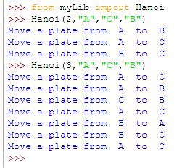
Example: Towers of Hanoi

Slide 41

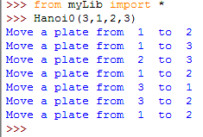
Example: Towers of Hanoi

Slide 42
Example: Towers of Hanoi
We will see that
m_{n} = 2^{n} – 1 = Θ(2^{n})
m₆₄ = 1.845*10¹⁹
If 1 move takes 1 s:
1.845*10¹⁹ s = 584.5 billion years

Slide 43
Example: Towers of Hanoi
Non-recursive solutions also exist

Slide 44
Plan for Analysis of Recursive Algorithms
Decide on a parameter indicating the size of an instance.
Identify the algorithm’s basic operation.
Check whether the number of times the basic op. is executed may vary on different inputs of the same size. If it may, the worst, average, and best cases must be investigated separately.
Set up a recurrence relation with an appropriate initial condition expressing the number of times the basic operation is executed.
If possible, solve the recurrence (or, at the very least, establish its solution’s order of growth) by any of the five (or other) methods.

Slide 45
While loops are sometimes analyzed by recurrence relations

Slide 46
Russian multiplication
result = 0
halves = x
doubles = y
while (halves > 0)
if halves mod 2 = 1
then result = result + doubles
halves = halves div 2
doubles = doubles * 2

Slide 47
Recall: Russian multiplication
Worst case
┌log₂x┐ [divisions by 2, multiplications by 2,
additions]
x < 10^{m}
log₂x < log₂(10^{m}) = m*log₂10
O(m)

Slide 48
Russian multiplication
Worst case
0, x=0
c_{x} =
3 + c_{x div 2} , x>0
Arithmetic operations
Best case …

Slide 49
Russian multiplication
Best case
0, x=0
c_{x} =
2 + c_{x div 2} , x>0
Arithmetic operations

Slide 50
While loops are sometimes analyzed by recurrence relations
sum = 0;
i = n;
while i > 0
sum = sum + A[i];
i = i div 3
0, n=0
a_{n} =
1 + a_{n div 3}, n>o

Slide 51
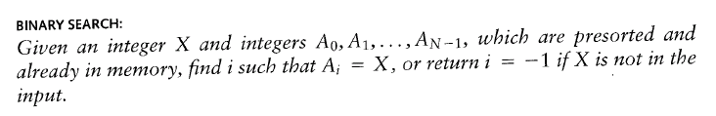
Binary Search

Slide 52
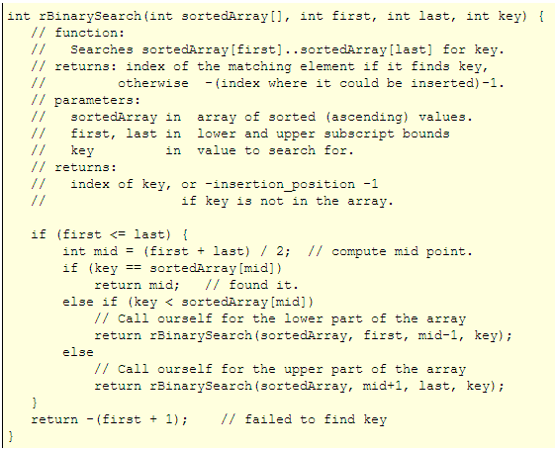
Binary Search: recursive solution

Slide 53
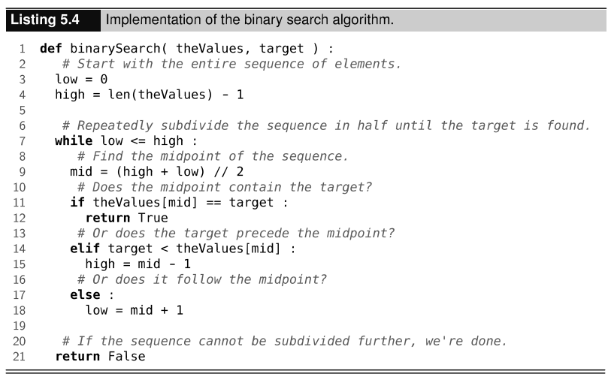
Binary Search: iterative solution

Slide 54
Binary Search: analysis
Worst case
Comparisons
more precisely, ⎡(n-1)/2⎤ = ⎣n/2⎦
0, n=0
c_{n} = 2, n=1
2 + c_{n/2} , n>1
For both the recursive and the iterative solutions
0, n=0
c_{n} = 2, n=1
2 + c_{⎣n/2⎦} , n>1
We will prove later that c_{n} = Θ(logn).
Clearly, binary search is more efficient than sequential search which is Θ(n).
54

